Slide 1
Control Flow Testing
Coverage Levels
Dr. Seemab Latif
4th March, 2011

Slide 2
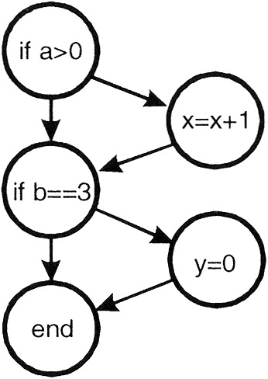
100% Statement Coverage
The lowest coverage level is "100% statement coverage" .
This means that every statement within the module is executed, under test, at least once.
if (a>0)
{x=x+1;}
if (b==3)
{y=0;}
Test Case:
a>0,b=3

Slide 3
Level 2: 100% Decision Coverage
A Decision is :
' A program point at which the control flow has two or more alternative routes. A node with two or more links to separate branches.‘
For example: if statement, switch statement
A Decision Coverage is :
' the percentage of the decision outcomes that have been exercised by a test case. 100% decision coverage implies both 100% branch coverage and 100% statement coverage.'
The objective of decision coverage testing is to show all the decisions within a component have been executed at least once.

Slide 4
Decision coverage is stronger than statement coverage.
100% decision coverage for a component is achieved by exercising all decision outcomes in the component.
100% decision coverage guarantees 100% statement coverage, but not vice versa.

Slide 5
Example
Age < 17
True
1. If age < 17
2. Display Error Message
3. Endif
Display
False
Exit
This would require 2 tests to achieve 100% decision coverage, but only 1 test to
achieve 100% statement coverage.
In this example there is one decision, and therefore 2 outcomes. To achieve 100% decision coverage we could have two tests: * Age less than 17(answer 'yes') * Age equal to or greater than 17 (answer 'no')

Slide 6
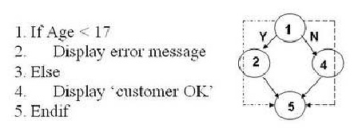
we will need 2 tests to achieve 100% decision coverage & also 2 tests to achieve 100% statement coverage.
This example would still result in two tests, as there is one decision therefore 2 outcomes to tests.

Slide 7
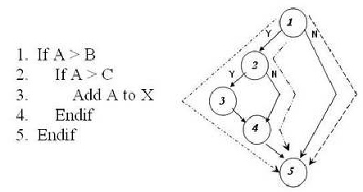
We will need 3 tests to achieve 100% decision coverage.
Here we have an example of a 'nested if'. We have 2 decisions, so you may think that 4 tests may be required to achieve 100% decision coverage (two for each decision).
This is NOT the case! We can achieve 100% decision coverage with three tests.
We need to exercise the 'Yes' outcome from the first decision ( line 1) twice, in order to subsequently exercise the 'Yes' and then the 'No' outcome from the nested if (line 2).
We need a further third test to ensure we exercise the 'No' outcome of the first decision (line 1).

Slide 8
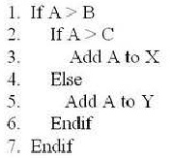
How much tests we need in this piece of code?

Slide 9
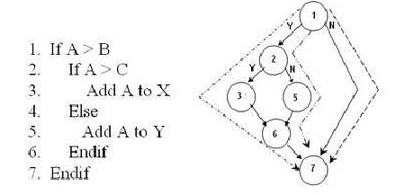
3 tests to achieve 100% decision coverage:
We need to exercise the 'Yes' outcome from the first decision ( line 1) twice, in order to subsequently exercise the 'Yes' and then the 'No' outcome from the nested if-else (line 2 and 4).
We need a further third test to ensure we exercise the 'No' outcome of the first decision (line 1).

Slide 10
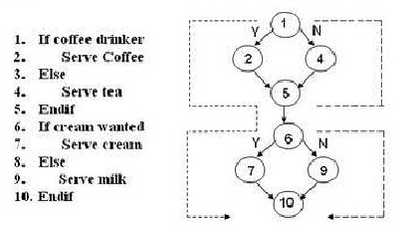
We will need 2 tests to achieve 100% decision. As the decisions are separate questions we only need two tests to achieve 100% decision coverage.
You may have thought that four tests were required - exercising the four different routes through the code, but remember, with decision testing our concern is to exercise each outcome of each decision at least once - as long as we have answered 'Yes' and 'No' to each decision we have satisfied the requirements of the technique.
The tests we have illustrated would need the following input conditions: * Coffee drinker wanting cream. * Non Coffee drinker not wanting cream (but milk).

Slide 11
Condition Coverage
Condition coverage reports the true or false outcome of each Boolean sub-statement, separated by && and || if they occur.
Condition coverage measures the sub-expressions independently of each other.
This measure is similar to decision coverage but has better sensitivity to the control flow.
However, full condition coverage does not guarantee full decision coverage

Slide 12
bool f(bool e) { return false; } bool a[2] = { false, false }; if (f(a && b)) {….} if (a[int(a && b)]) {….} if ((a && b) ? false : false) ...
All three of the if-statements above branch false regardless of the values of a and b. However if you exercise this code with a and b having all possible combinations of values, condition coverage reports full coverage.

Slide 13
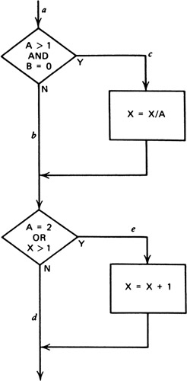
This control flow has four conditions: A > 1, B = 0, A = 2, and X > 1. Hence enough test cases are needed to force the situations where A > 1, A=1, B = 0, and B != 0 are present at point a and where A = 2, A != 2, X > 1, and X = 1 at point b. A sufficient number of test cases satisfying the criterion, and the paths traversed by each, are :
A=2, B=0, X=4 ace A=1, B=1, X=1 adb
Condition coverage is usually superior to decision coverage in that it may cause every individual condition in a decision to be executed with both outcomes, where decision coverage does not.

Slide 14
if(A&&B)
Then {x=x+1;}
If the decision if(A&B) is being tested, the condition-coverage criterion would allow one to write two test cases A is true, B is false, and A is false, B is true but this would not cause the THEN clause of the IF to execute.
The condition-coverage tests for the earlier example covered all decision outcomes, but this was only by chance. For instance, two alternative test cases
A = 1, B = 0, X = 3 A = 2, B = 1, X = 1
cover all condition outcomes, but they cover only two of the four decision outcomes

Slide 15
100% Decision/Condition Coverage
Combines both 100% Decision Coverage and 100% Condition Coverage
At this level test cases are created for every condition and every decision.
if(A&&B)
Then {x=x+1;}
Four two case:
A = True, B = True
A = False, B = False
These 2 test cases cover both Decision Coverage and Condition Coverage

Slide 16
A weakness with decision/condition coverage is that although it may appear to exercise all outcomes of all conditions and decisions, it frequently does not because certain conditions mask other conditions in multiple conditions.

Slide 17
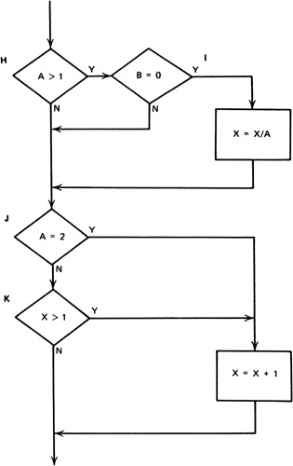
A = 1, B = ?, X = 3 A = 2, B = 0, X = ?
A = 1, B = ?, X = 1
A = 2, B = 0, X = ?
In this example, decision/condition coverage does not invoke the false outcome of decision I and the true outcome of decision K.
The reason is that results of conditions in && and || expressions can mask or block the evaluation of other conditions.
For instance, if an && condition is false, none of the subsequent conditions in the expression need be evaluated. Likewise, if an || condition is found to be true, none of the subsequent conditions need be evaluated.
Hence, errors in logical expressions are not necessarily made visible by the decision/condition coverage criteria.

Slide 18
Multiple Condition Coverage
A criterion that covers this problem, and then some, is multiple-condition coverage. This criterion requires one to write sufficient test cases such that all possible combinations of condition outcomes in each decision, and all points of entry, are invoked at least once.

Slide 19
Using multiple condition coverage, eight combinations must be covered by test cases:
1. A > 1, B = 0 2. A > 1, B ≠ 0 3. A ≤ 1, B = 0 4. A ≤ 1, B ≠ 0 5. A = 2, X > 1 6. A = 2, X = 1 7. A ≠ 2, X > 1 8. A ≠ 2, X = 1
These combinations to be tested do not necessarily imply that eight test cases are needed. In fact, they can be covered by four test cases. The test-case input values, and the combinations they cover, are
A = 2, B = 0, X = 4 covers 1, 5
A = 2, B = 1, X = 1 covers 2, 6
A = 1, B = 0, X = 2 covers 3, 7
A = 1, B = 1, X = 1 covers 4, 8

Slide 20
Achieving 100% multiple condition coverage also achieves decision coverage, condition coverage, and decision/condition coverage. Note that multiple condition coverage does not guarantee path coverage.

